Slide 1
Scheduling Policies

Slide 2
What is a scheduling policy?
On context switch, which process to run next, from set of ready processes?
OS scheduler schedules the CPU requests (bursts) of processes
CPU burst = the CPU time used by a process in a continuous stretch
If a process comes back after I/O wait, it counts as a fresh CPU burst

Slide 3
What are we trying to optimize?
Maximize (utilization = fraction of time CPU is used)
Minimize average (turnaround time = time from process arrival to completion)
Minimize average (response time = time from process arrival to first scheduling)
Fairness: all processes must be treated equally
Minimize overhead: run process long enough to amortize cost of context switch (~1 microsecond)

Slide 4
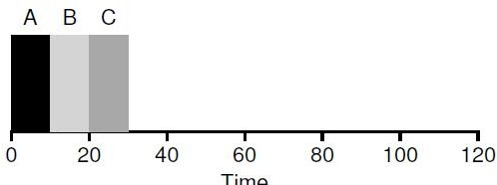

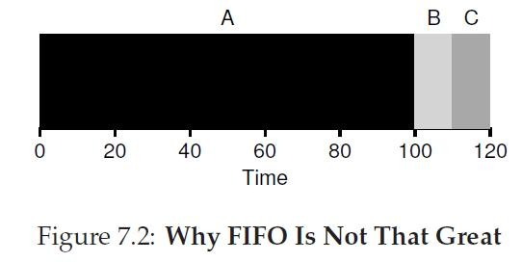
First-In-First-Out (FIFO)
Example: three processes arrive at t=0 in the order A,B,C
Problem: convoy effect
Turnaround times tend to be high

Slide 5
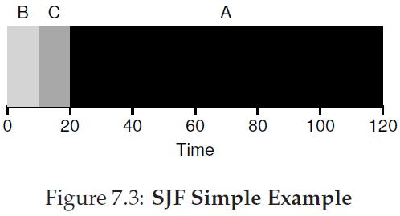
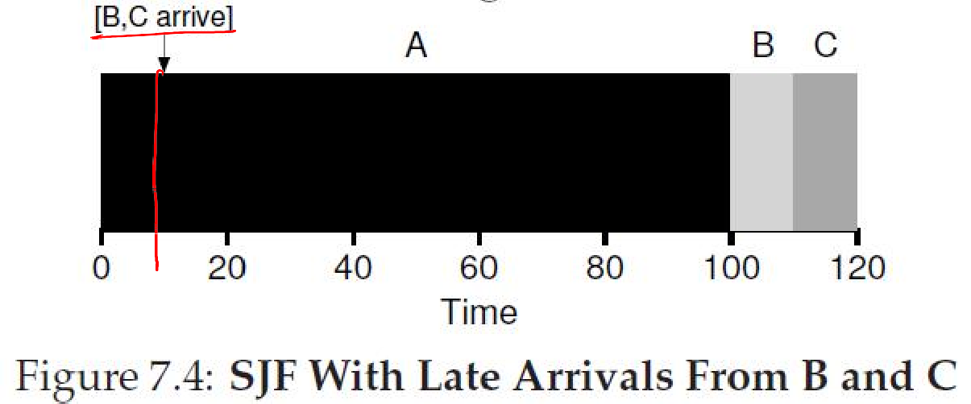
Shortest Job First (SJF)
Provably optimal when all processes arrive together.
SJF is non- preemptive, so short jobs can still get stuck behind long ones.

Slide 6
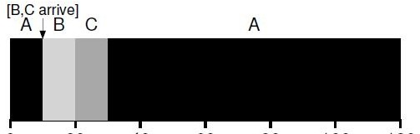
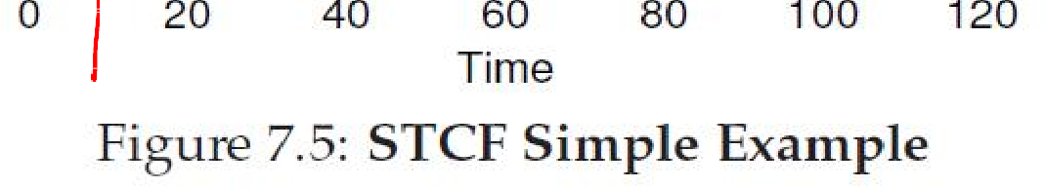
Shortest Time-to-Completion First (STCF)
Also called Shortest Remaining Time First (SRTF)
Preemptive scheduler
Preempts running task if time left is more than that of new arrival

Slide 7
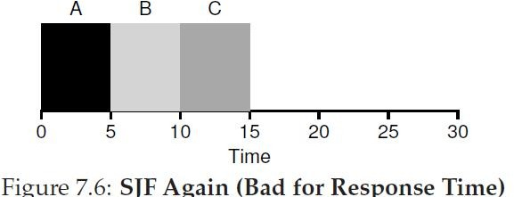
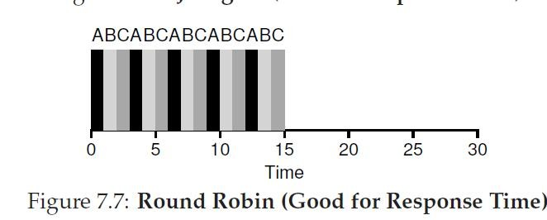
Round Robin (RR)
Every process executes for a fixed quantum slice
Slice big enough to amortize cost of context switch
Preemptive
Good for response time and fairness
Bad for turnaround time

Slide 8
Schedulers in real systems
Real schedulers are more complex
For example, Linux uses a Multi Level Feedback Queue (MLFQ)
Many queues, in order of priority
Process from highest priority queue scheduled first
Within same priority, any algorithm like RR
Priority of process decays with its age

